Slide 1
HR Dashboard
Tableau Presentation

Slide 2
Why HR Dashboard is Important
Helps forecast future staffing needs
Tracks key performance indicators (KPIs) like turnover rates or absenteeism to allow HR spot potential issues early and address them.
Helps align HR initiatives ( talent acquisition, training programs) directly with broader business goals and financial outcomes.
Moves decision-making beyond "gut feelings" by providing real-time, evidence-based insights into workforce performance, engagement, and retention.
Provides managers and employees with a shared understanding of performance goals and organizational health indicators, leading to better communication and shared responsibility.

Slide 3
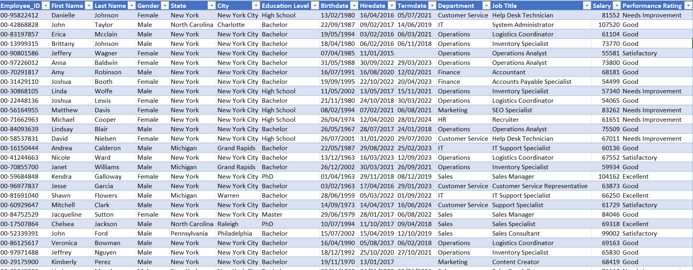
Employee Data for HR Dashboard

Slide 4
HR Dashboard Design
Overview
Shows hired/terminated employees by:
Year
Demographics
Displays hired/terminated employees by:
Income
Tracks employees by:
Department
Location
Gender
Education & Age
Education & Performance
Education & Age
Age & Salary

Slide 5
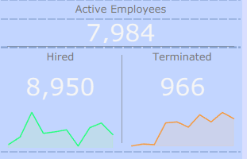
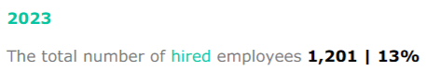
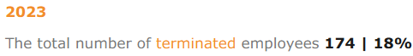
Overview Section
Active Employees: shows total # of active employees
Hired: shows total # of hired employees
Terminated: shows total # of terminated employees
Hired line chart: displays total hired employees for a particular year
Terminated line chart: displays total terminated employees for a particular year

Slide 6
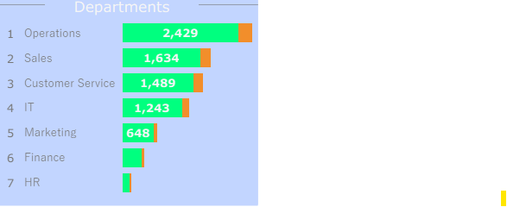
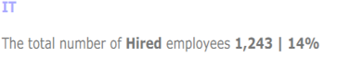
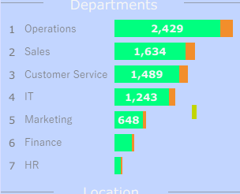
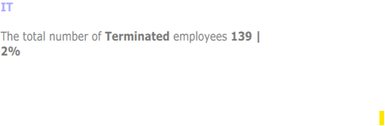
Overview Section
Departments bar chart displays:
Total hired employees by department in green
Total terminated employees by department in orange

Slide 7
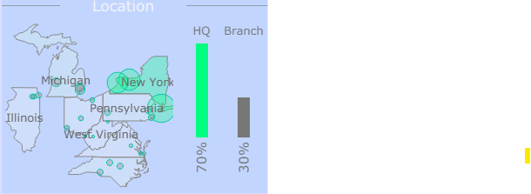
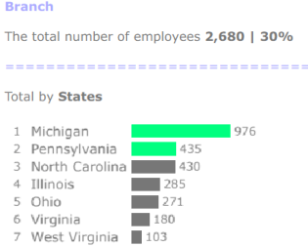

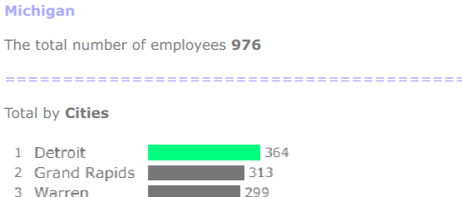
Overview Section
Location section displays:
Map: shows total hired employees by US state and city (state with most employees is highlighted in green)
Map city tooltip: shows total hired employees in the selected city
Map state tooltip: shows total hired employees in the selected state as well as employee total bar chart by city
Bar chart: displays hired employees in the company headquarter (HQ) and branches
Bar chart tooltip: shows total hired employees in the selected HQ/Branch as well as employee total bar chart by state
Most branch employees live in Michigan & Pennsylvania states
Most Michigan employees live in Detroit city

Slide 8
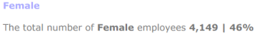
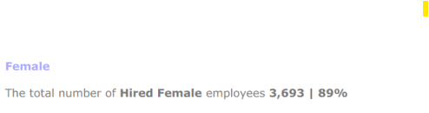
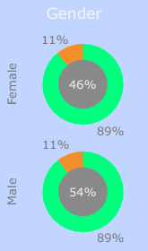
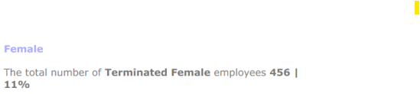
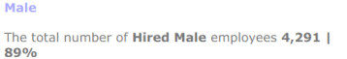
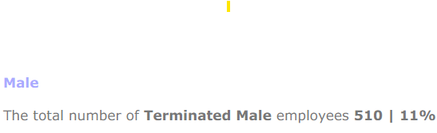
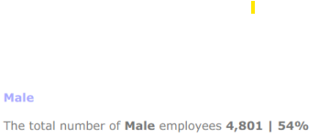
Demographics Section
Gender female donut chart displays:
Inner donut: shows total # of female employees and their percentage out of all employees
Outer donut :
total # of hired female employees and their percentage out of all hired employees in green color
total # of terminated female employees and their percentage out of all terminated employees in orange color
Gender male donut chart displays:
Inner donut: shows total # of male employees and their percentage out of all employees
Outer donut :
total # of hired male employees and their percentage out of all hired employees in green color
total # of terminated male employees and their percentage out of all terminated employees in orange color

Slide 9
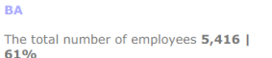
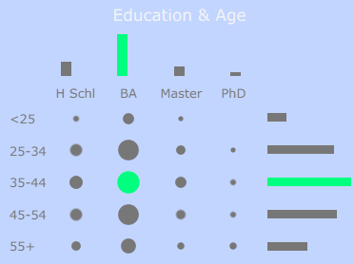
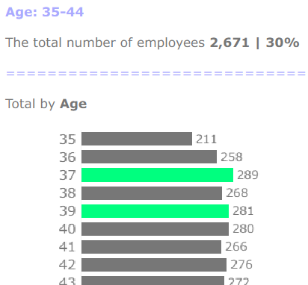
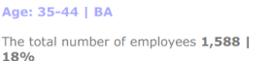
Demographics Section
Education & Age displays:
Heat map: shows total # of employees within an age group and with the certain education and their percentage out of all employees
Top bar chart: shows total # of employees with the certain education and their percentage out of all employees
Right bar chart: shows total # of employees within an age group and their percentage out of all employees
The most # of employees in the certain category is displayed in green color
Most # of employees within 35-44 age category are either 37 or 39 years old
Most # of employees are within 35-44 age category and have a Bachelor’s degree

Slide 10
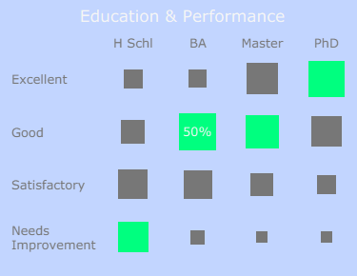
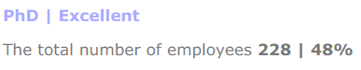
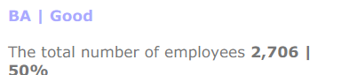
Demographics Section
Education & Performance displays:
Heat map: shows total # of employees with the certain education by their performance
The most # of employees in the category is displayed in green color
48% of employees (out of 228) with Phd have excellent performance
Most # of employees (2,706) have a Bachelor’s degree and Good performance

Slide 11
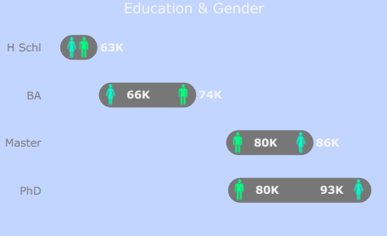

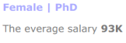
Income Section
Education & Gender displays:
Barbell chart (shows distance between values for gap analysis): compares salary for male and female employees with same education levels
Males with Bachelor’s degree have bigger average salary than Female Bachelor’s: 74K vs 66k
Female Phds have bigger average salary than Male Phds: 93K vs 80k

Slide 12
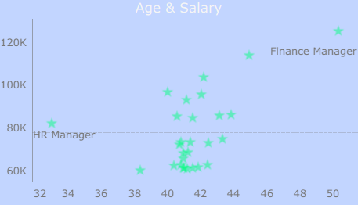
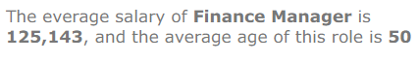
Income Section
Age & Salary displays:
Scatter Plot: compares salary and age for different job titles

Slide 13
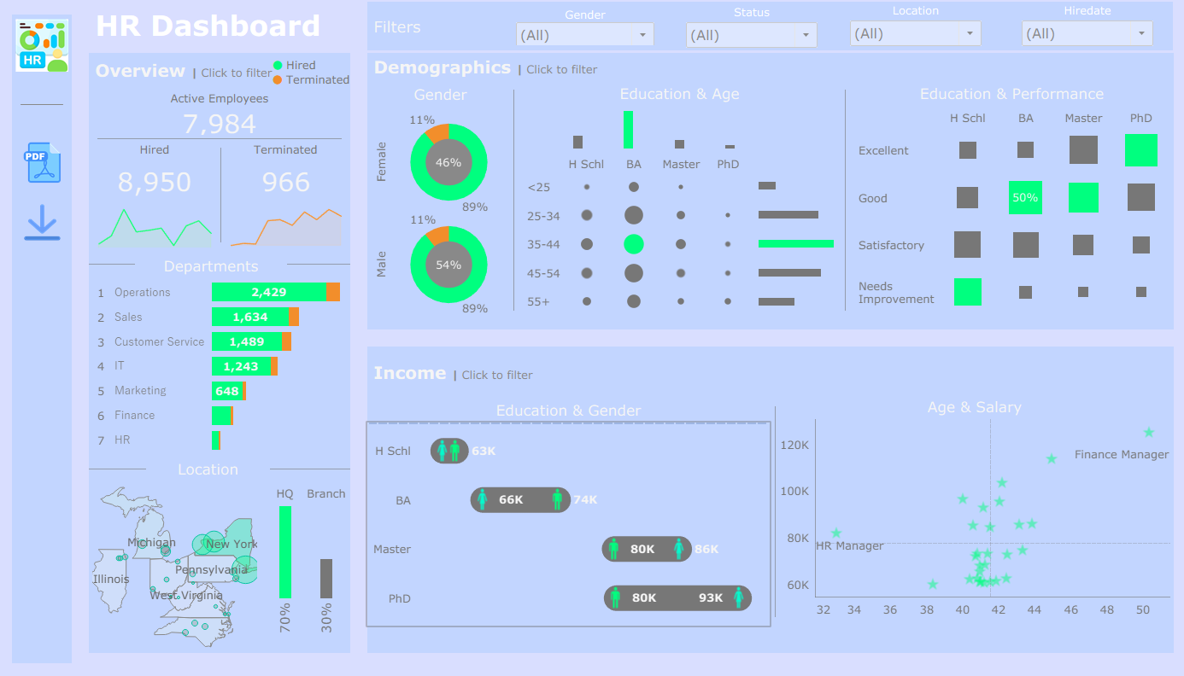

Slide 14
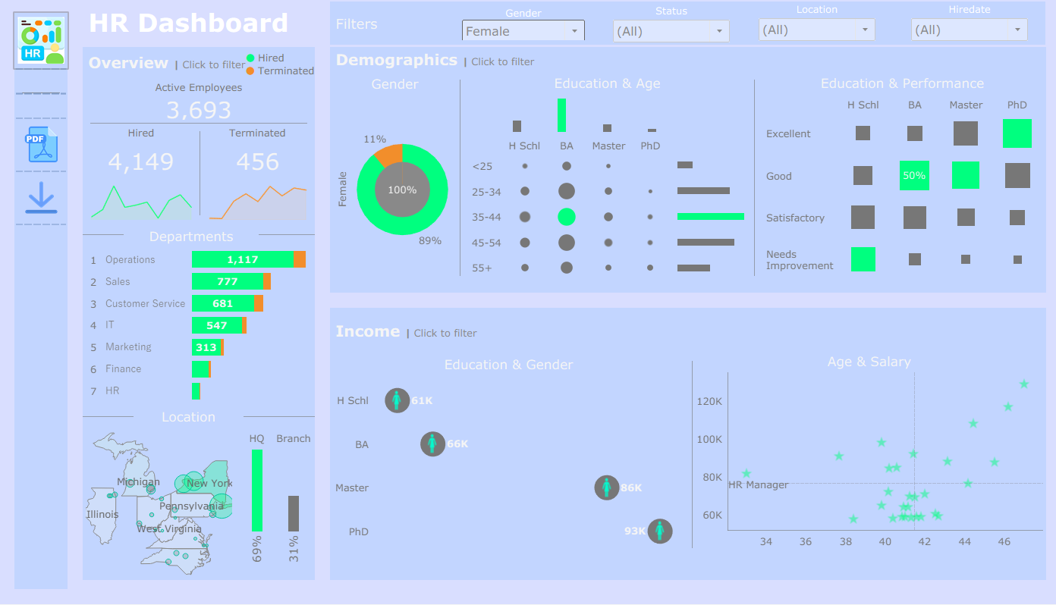
HR Dashboard with Gender filter set to Female

Slide 15
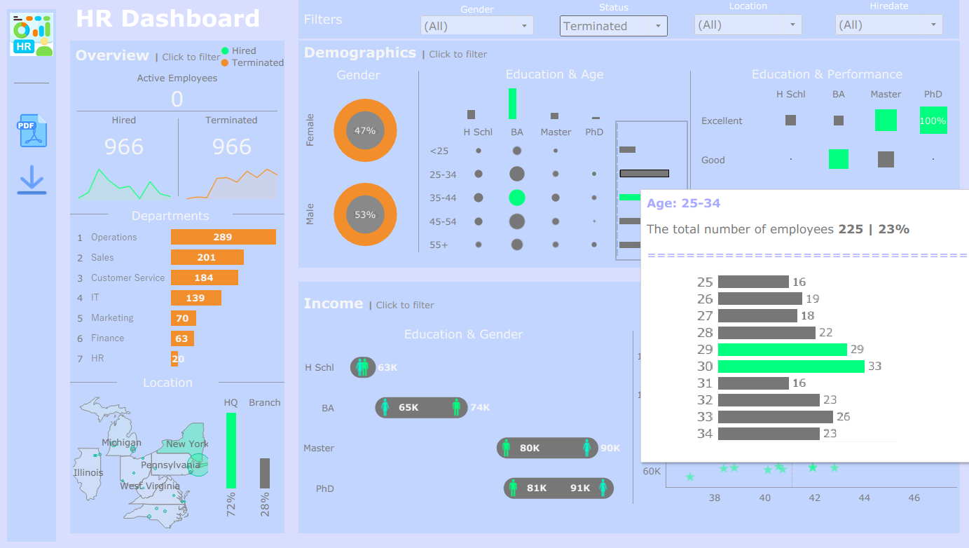
HR Dashboard with Status filter set to Terminated

Slide 16
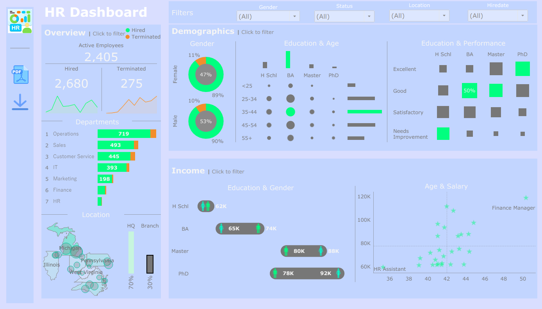
HR Dashboard with Location filter set to Branch

